Slide 1
Firewall
Firewall Characteristics
Types of Firewalls
Overview of Firewall Configuration

Slide 2
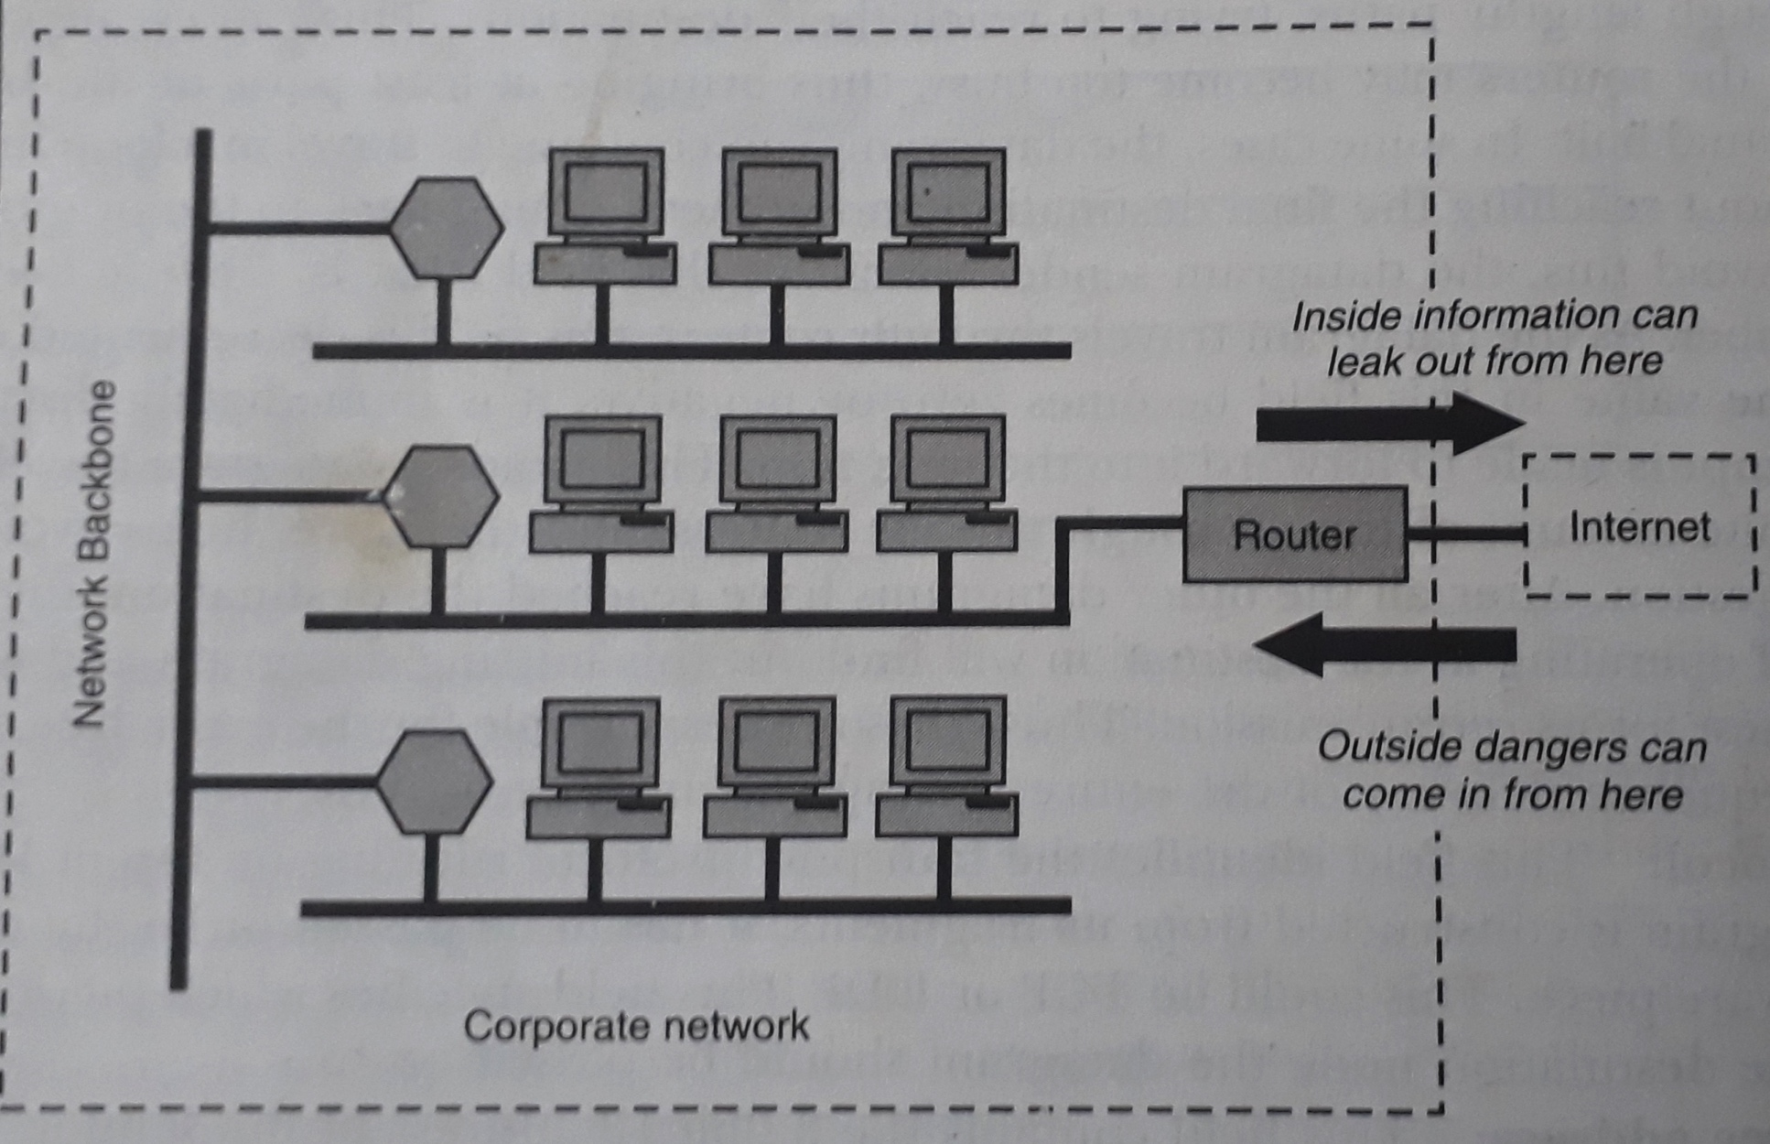
Introduction

Slide 3
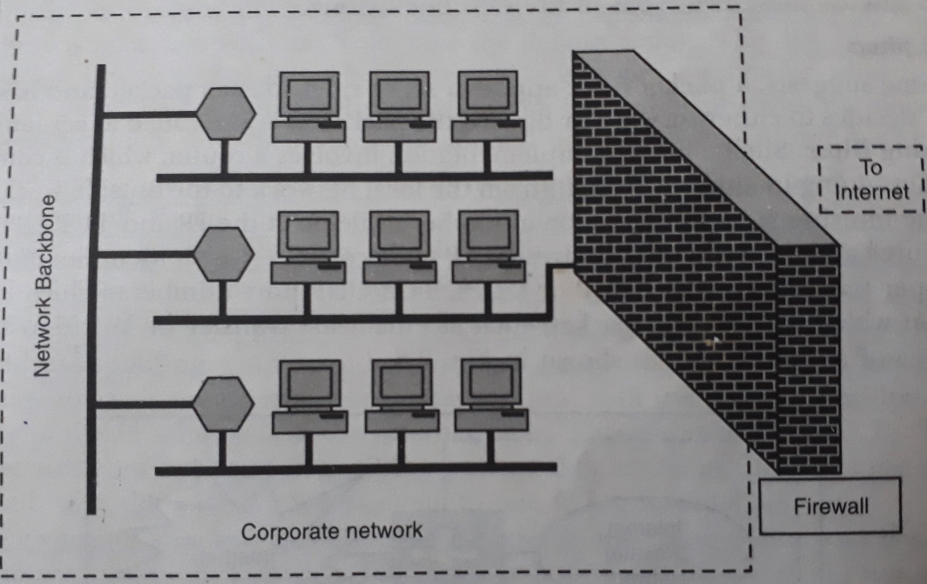
Firewall

Slide 4
Firewall Characteristics
All traffic from inside to outside, and vice versa, must pass through the firewall. This is achieved by physically blocking all access to the local network except via the firewall.
Only authorized traffic, as defined by the local security policy, will be allowed to pass.
The firewall itself is immune to penetration.

Slide 5
Types of Firewalls
Packet Filters
Application Gateways

Slide 6
Packet Filters
A packet filter applies a set of rules to each packet, and based on the outcome, decides to either forward or discard the packet. It is also called as screening router or screening filter.
Filtering rules are based on information contained in a network packet, such as ----
Source and destination IP addresses
IP protocol field
TCP/UDP port numbers

Slide 7
Application Gateways
An application gateway is also called as a proxy server because it acts like a proxy and decides about the flow of application level traffic.
The user contacts the application gateway using a TCP/IP application, such as TELNET of FTP, and gateway asks the user for the name of the remote host to be accessed. When the user responds and provides valid user-ID and password, the gateway contacts the application on the remote host and relays TCP segments containing the application data between the two endpoints.

Slide 8
Overview of Firewall Configurations
There are three possible configurations of firewalls:
Screened host firewall, single-homed bastion
Screened host firewall, dual-homed bastion
Screened subnet firewall

Slide 9
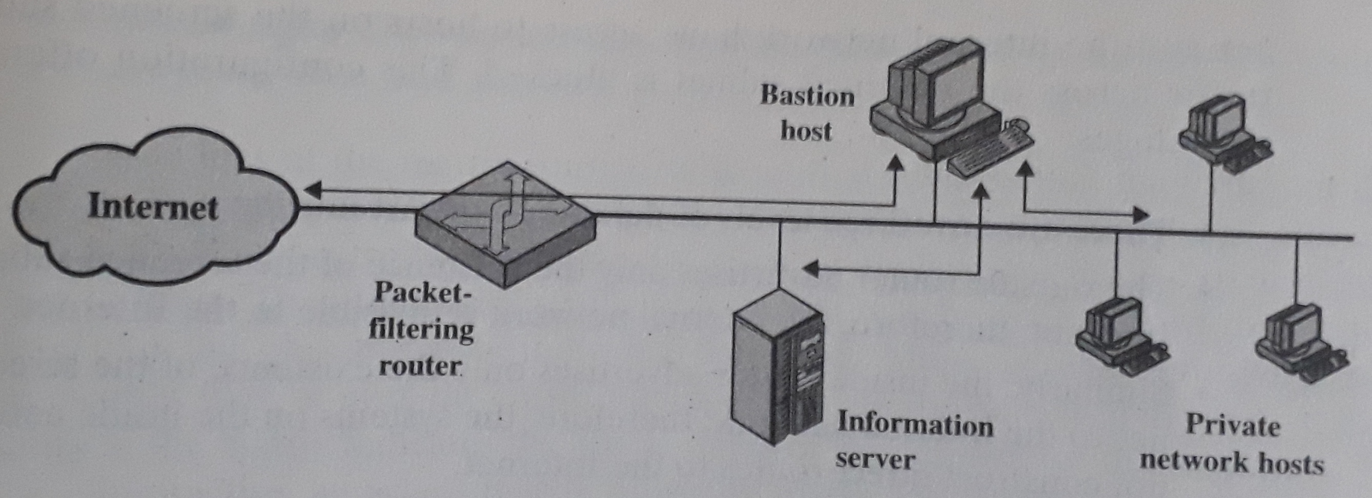
Screened Host Firewall, Single-homed Bastion

Slide 10
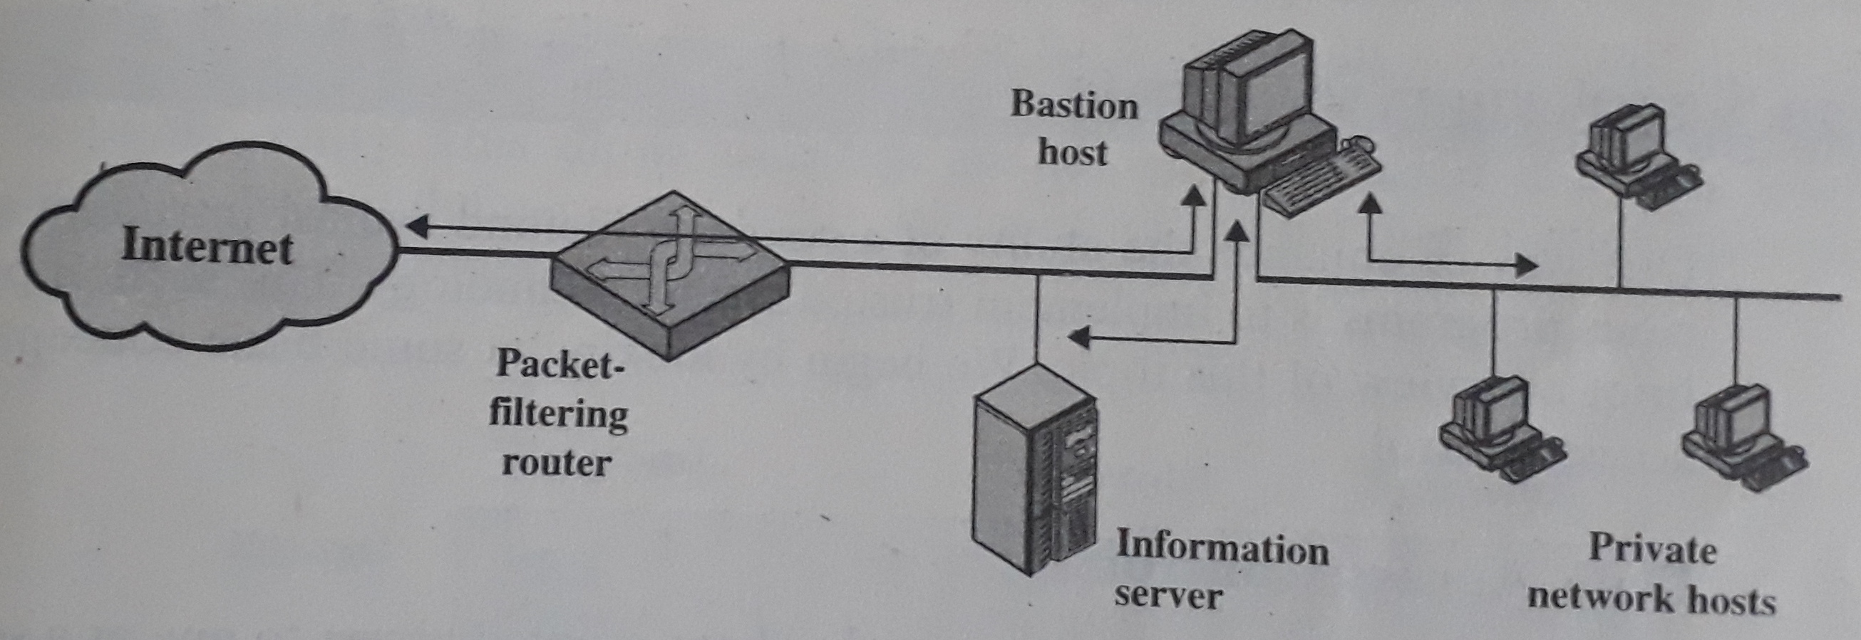
Screened Host Firewall, Dual-homed Bastion

Slide 11
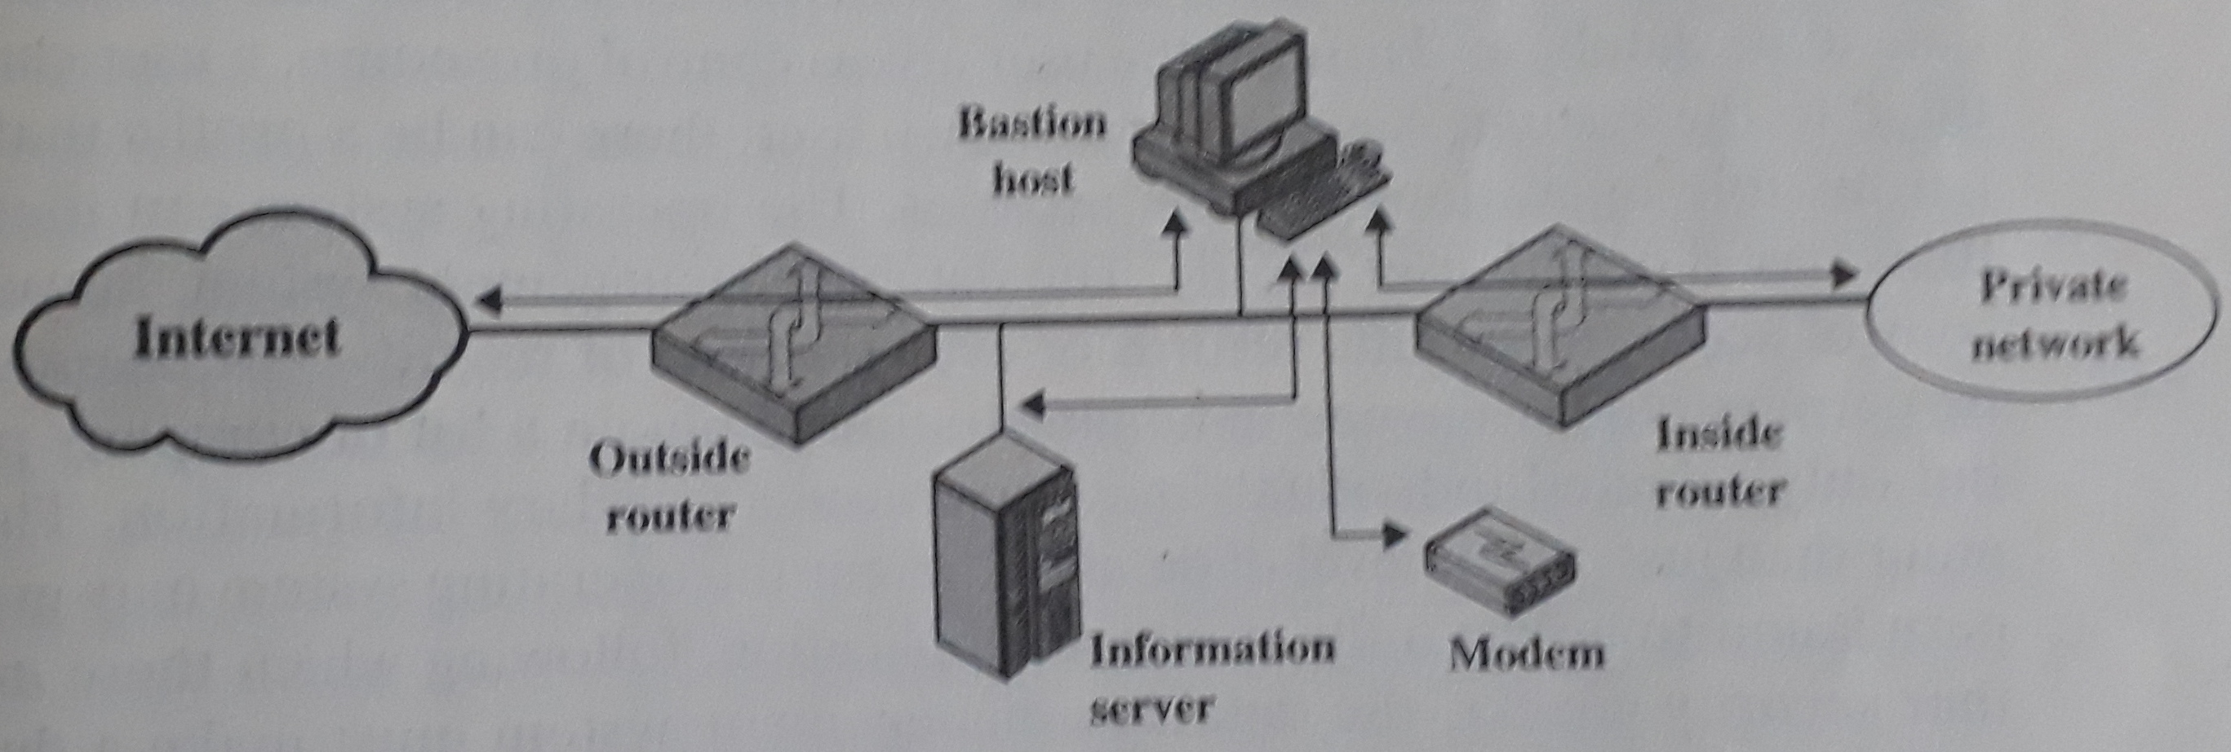
Screened Subnet Firewall

Slide 12
Assignment
Write down the advantages and disadvantages of different types of firewalls. [4]
What is dynamic / stateful packet filter? [3]
What is circuit-level gateway? [3]

Slide 13
THANK YOU

